Slide 1
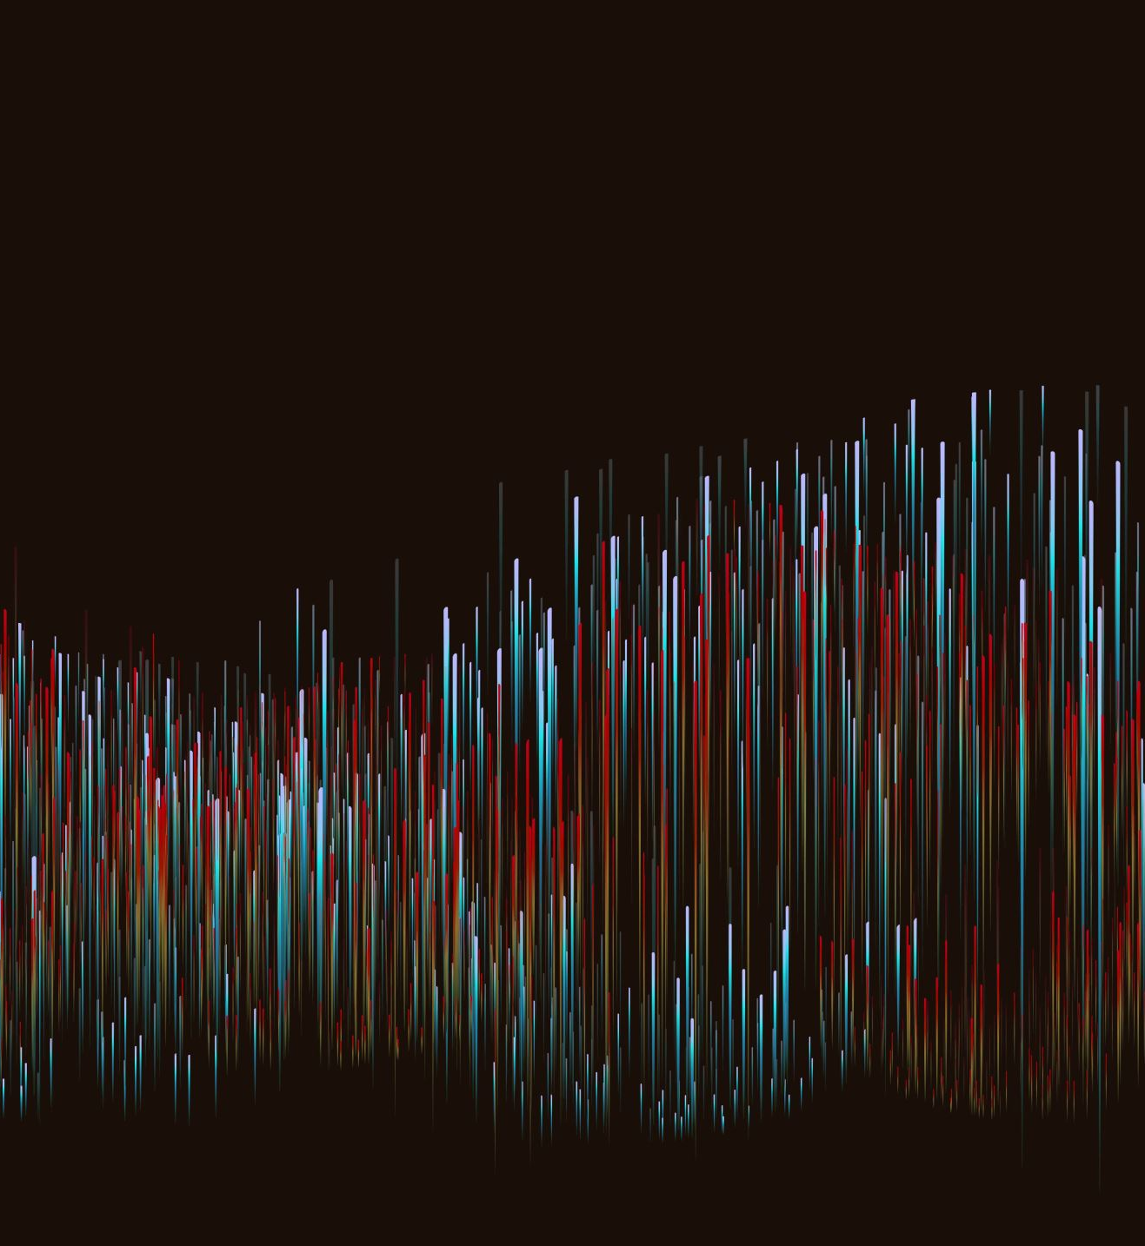
Overfitting and Underfitting
By Muhammad Arslan Shahzad @ICodeGuru

Slide 2
Generalization in ML
In ML we refers the learning of target function from training data as inductive learning.
Inductive Learning: Learning general concepts from specific examples i.e. supervised learning do
Generalization is how well the concept is learned by the ML model and applied to a specific examples that is not seen by the model when it was learning.
The end goal of ML to generalize well from training data from problem domain, and leading to make prediction in future on data the model never seen before.

Slide 3

Statistical Fit
In statistics a fit refers to how well you approximate (predict) a target function.
Statistics also describe the goodness of fit which refers to measures used to estimate how well the prediction of function matches the target function.
Calculating the residuals errors

Slide 4
Overfitting in ML
Overfitting happens when a model learns the detail and noise in the training data to the extent that it negatively impacts the performance on the model on new data.
Which means the noise and random fluctuation in the training data is picked up and learned as concept by model.
Overfitting is nonparametric and nonlinear model that have more flexibility when learning a target function.
Examples Decision tree are nonparametric ml model that is very flexible and is subject to overfitting the training data. And problem can be addressed by pruning the tree after it has learned in order to remove some of the details it has picked up.

Slide 5
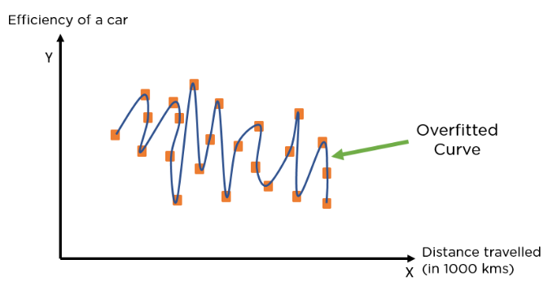
Example
Overfitting can happen due to low bias and high variance.

Slide 6
Reasons of Overfitting
Data used for training is not cleaned and contains noise in it
Model has high variance
Size of training data is not enough
Model is too complex

Slide 7
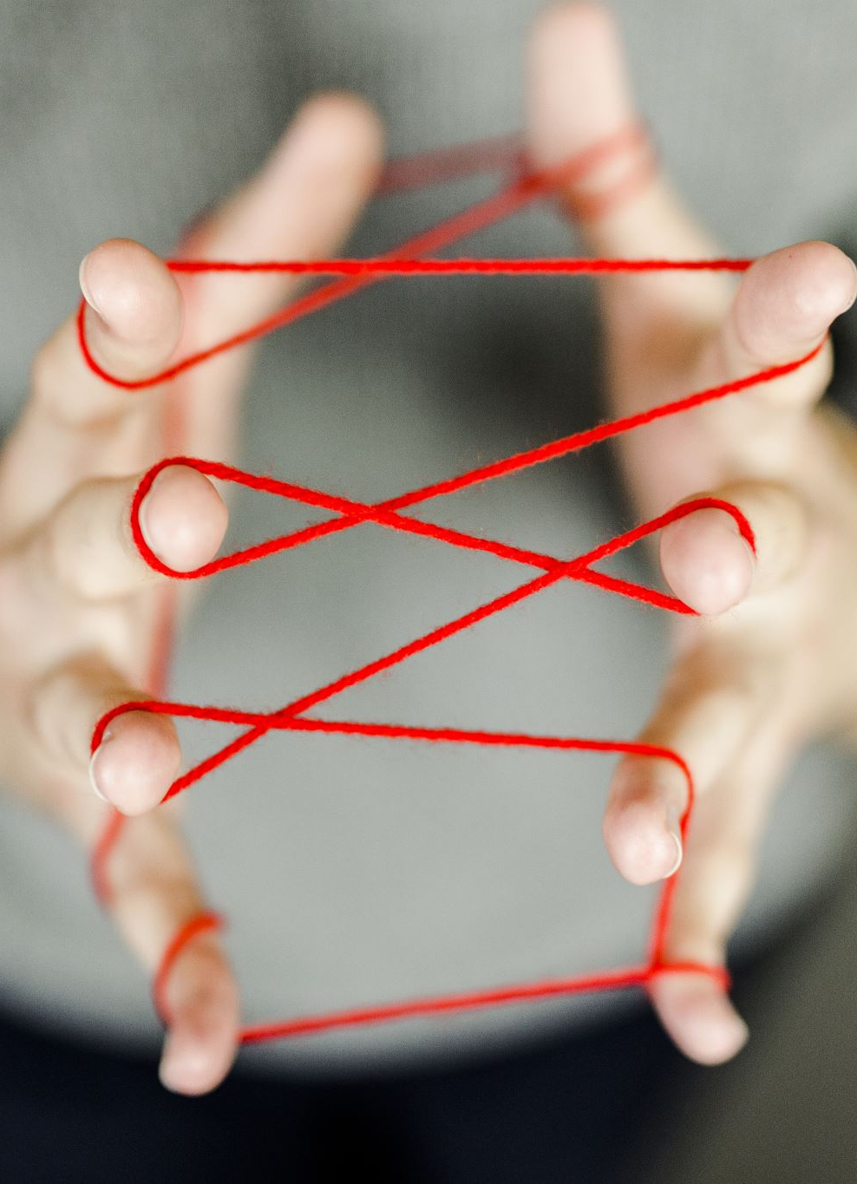
Handling Overfitting
Using k-fold cross validation
Using regulation techniques like lasso and ridge
Training model with sufficient data
Adopting ensembling techniques

Slide 8
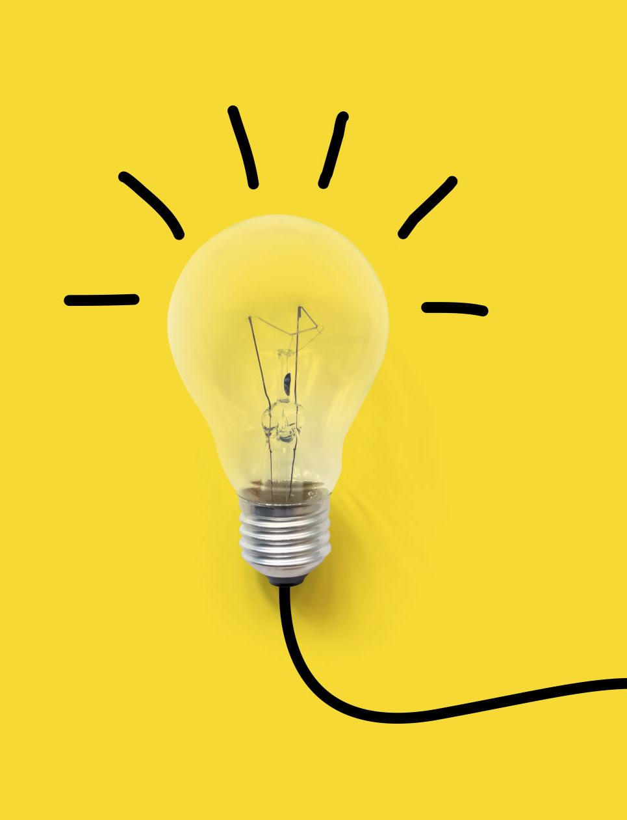
Underfitting
When a model has not learned the patterns in the training data well, then its unable to generalize well on the new data.
An underfit model has poor performance on the training data and will result in unreliable prediction
Occurs due to high bias and low variance.

Slide 9
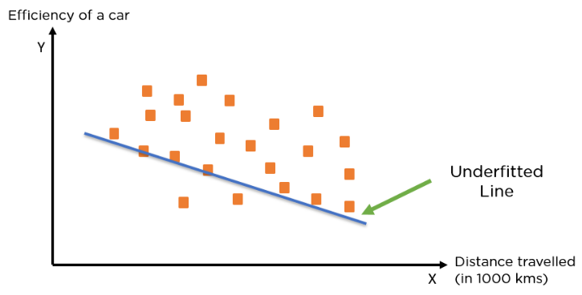
Example

Slide 10
Why Underfitting Happen
Data used for training is not cleaned and having noise
The model is highly bias
The size of training data is not enough
The model is too simple

Slide 11
Tackle Underfitting
Increase the number of features in dataset
1
Increase model complexity
2
Reduce the noise in training data
3
Increase the duration of training the dataset.
4

Slide 12
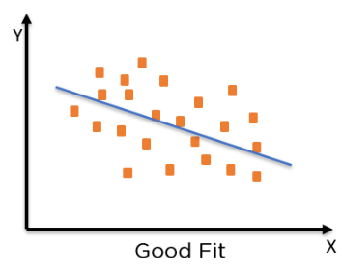
Good fit
A line or curve that best fits the data is neither overfitting nor underfitting models but its just the precise.

Slide 13
Good fit in the ML
To find a good fit we have to consider the performance of ML model overtime with training data.
As the model starts to learn over time the error for the model is reduced for training as well as test dataset.
Conversely if we train the model for too long it will learn the unnecessary details and the noise in dataset and leading to overfitting
For a good fit, we have to stop training at a point once error start increase

Slide 14
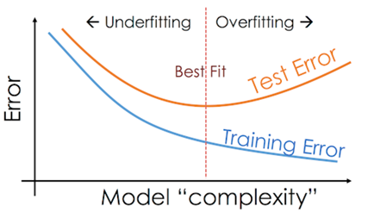
Good fit

